Slide 1

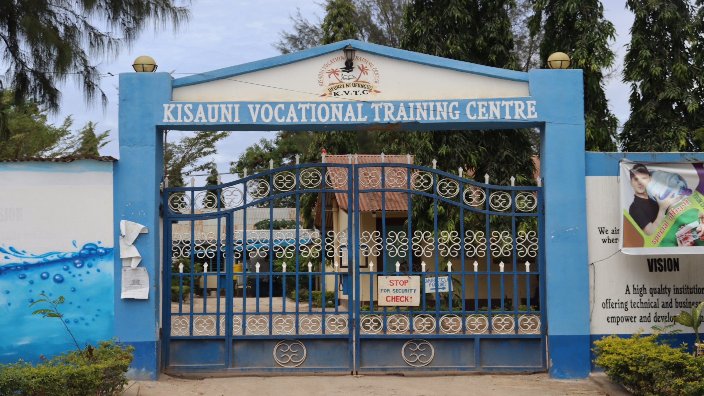
OFFERS THE FOLLOWING F

Slide 2
TECHNICAL COURSES
• ELECTRICAL INSTALLATION & SOLAR TECHNOLOGY
• LIGHT VEHICLE MECHANIC
• HAIRDRESSING AND BEAUTY THERAPY
• CARPENTRY AND JOINERY
• PLUMBING AND PIPE FITTING
• BUILDING TECHNOLOGY (MASONRY)
• TAILORING AND DRESSMAKING
• FOOD AND BEVERAGE PRODUCTION AND SERVICE
• COMPUTER STUDIES
• WELDING & FABRICATION
• PAINTING & SIGN WRITING
REFRIGERATION AND AIRCONDITIONING

Slide 3
BUSINESS AND SOCIAL STUDIES COURSES
Accounting
Business Management
ATD and CPA
Storekeeping
Secretarial
HR Management
ECDE

Slide 4
THE INSTITUTION OFFERS ITS EXAMS THROUGH THE FOLLOWING EXAMINATION BODIES:-
KNEC
NITA
KASNEB
ICM
ABMA
KVTCEB

Slide 5
ELECTRICAL ENGINEERING DEPARTMENT
GRADE TEST III, II, AND I - IN ELECTRICAL INSTALLATION AND SOLAR TECHNOLOGY
ARTISAN CERTIFICATE - IN ELECTRICAL INSTALLATION
CRAFT CERTIFICATE - IN ELECTRICAL & ELECTRONICS ENGINEERING (POWER) MODULES ONE AND TWO.

Slide 6
MECHANICAL ENGINEERING DEPARTMENT
ARTISAN CERTIFICATE - IN MOTOR VEHICLE MECHANICS
CRAFT CERTIFICATE - IN AUTOMOTIVE ENGINEERING MODULES ONE AND TWO.
GRADE TEST III,II AND I IN-
LIGHT VEHICLE MECHANICS
PLANT MECHANICS
MOTOR VEHICLE ELECTRICIAN
WELDING AND FABRICATION

Slide 7
BUILDING TECHNOLOGY (MASONRY)
ARTISAN CERTIFICATE -IN MASONRY
CRAFT CERTIFICATE - IN BUILDING TECHNOLOGY (CONSTRUCTION TECHNOLOGY)
GRADE TEST III, II AND I- IN MASONRY

Slide 8
FOOD AND BEVERAGE PRODUCTION AND SERVICE
Artisan Certificate in -Food and Beverage Production and Service
Craft Certificate In -Food and Beverage Production and Service
Grade Test Certificate in - Food and Beverage Production and Service

Slide 9
INFORMATION & COMMUNICATION TECHNOLOGY
COURSE | PARTICULARS | REQUIREMENTS
APPLICATION PACKAGES | 4,000/= Inclusive Of An Admission Fee Of 200/= Minimum Payment On Admission 3,000/= Duration -3 Months, 2 Hours. Daily From Monday To Friday | Text Book @ 500/= Flash Disk
COMPUTER MAINTENANCE | 15,000/= Inclusive Of An Admission Fee Of 500/= Minimum Payments On Admission 5,000/= Duration – 6 months | 2 Exercise Books 1 File Copies Of ‘O’ Level Certificates Software CD/DVDs @ 700/= ID Card @ 200/=
CCTV INSTALLATION AND MAINTENANCE | 10,000/= Inclusive Of An Admission Fee Of 500/= Minimum Payments On Admission 5,000= Duration – 3 months 2 hours daily from Monday to Friday | Copies Of ‘O’ Level Certificates ID Card @ 200/= 1 Exercise Book 1 File
GRAPHICS | Corel Draw For 2 Weeks @ 1,500/= MS Publisher For 2 Weeks @ 1,500/= Email / Internet For 1 Week @ 1,000/= | Holder of Certificate in Computer Applications.
CISCO | IT ESSENTIALS | Copies Of ‘O’ Level Certificates Software CD/DVDs @ 700/= ID Card @ 200/=
CRAFT IN ICT | D and above in KCSE | Copies Of ‘O’ Level Certificates Software CD/DVDs @ 700/= ID Card @ 200/=

Slide 10
HAIR DRESSING AND BEAUTY THERAPY
Artisan Certificate- in Hair Dressing & Beauty Therapy Level One and Two.
Grade Test III,II And I
Hair Dressing
Beauty Therapy

Slide 11
CARPENTRY AND JOINERY
Artisan Certificate in -Carpentry and Joinery
Grade Test III,II and I in - Carpentry and Joinery

Slide 12
PLUMBING AND PIPE FITTING COURSE
ARTISAN CERTIFICATE IN - PLUMBING
GRADE TEST III, II AND I - IN PLUMBING AND PIPE FITTING

Slide 13
TAILORING AND DRESSMAKING
FASHION AND DESIGN
ARTISAN CERTIFICATE -IN GARMENT MAKING
GRADE TEST III,II AND I -IN
    DRESS MAKING
    TAILORING

Slide 14
PAINTING & SIGN WRITING COURSE
ARTISAN CERTIFICATE IN SIGN WRITING AND PAINTING
GRADE TEST III,II AND I-IN PAINTING
AND DECORATION

Slide 15
CRAFT MODULE ONE FEES STRUCTURE
VOTE HEAD: | TERM 1: | TERM II: | TERM III: | TOTAL:
Admission fee | 500.00 | - | - | 500.00
Tuition fees | 11,000.00 | 11,000.00 | 11,000.00 | 33,000.00
Caution money | 1,000.00 | - | - | 1,000.00
Development fee | 600.00 | 600.00 | 600.00 | 1,800.00
Examination fee | 500.00 | 500.00 | 500.00 | 1,500.00
Computer fee | 500.00 | 500.00 | 500.00 | 1,500.00
Activity fee | 300.00 | 300.00 | 300.00 | 900.00
Medical fee | 200.00 | 200.00 | 200.00 | 600.00
Tools replacement | 300.00 | 300.00 | 300.00 | 900.00
Training material fee | 3,000.00 | 3,000.00 | 3,000.00 | 9,000.00
Total: | 17,900.00 | 16,400.00 | 16,400.00 | 50,700.00

Slide 16
ARTISAN 1ST YEAR
Vote Head | Term 1: | Term II: | Term III: | Total:
Admission | 500.00 | - | - | 500.00
Tuition fee | 10,000.00 | 10,000.00 | 10,000.00 | 30,000.00
Caution money | 500.00 | - | - | 500.00
Development | 600.00 | 600.00 | 600.00 | 1,800.00
Examination | 500.00 | 500.00 | 500.00 | 1,500.00
Computer fee | 500.00 | 500.00 | 500.00 | 1,500.00
Activity fee | 300.00 | 300.00 | 300.00 | 900.00
Medical fee | 200.00 | 200.00 | 200.00 | 600.00
Tools replacement | 300.00 | 300.00 | 300.00 | 900.00
Training material fee | 3,000.00 | 3,000.00 | 3,000.00 | 9,000.00
Total | 16,400.00 | 15,400.00 | 15,400.00 | 47,200.00

Slide 17
NITA GRADE TEST III FEES STRUCTURE
VOTE HEAD: | TERM I | TERM II | TERM III | TOTAL:
Admission fee | 500.00 | - | - | 500.00
Tuition fees | 7,500.00 | 7,500.00 | 7,500.00 | 22,500.00
Caution money | 500.00 | - | - | 500.00
Development | 600.00 | 600.00 | 600.00 | 1,800.00
Computer fees | 500.00 | 500.00 | 500.00 | 1,500.00
Activity fee | 300.00 | 300.00 | 300.00 | 900.00
Medical fee | 200.00 | 200.00 | 200.00 | 600.00
Tools replacement | 300.00 | 300.00 | 300.00 | 900.00
Training material | 2,000.00 | 2,000.00 | 2,000.00 | 6,000.00
Total | 12,400.00 | 11,400.00 | 11,400.00 | 35,200.00

Slide 18
GOBLUE
WE ALSO OFFER GOBLUE COURSES AND MARINE RELATED TRAINING ON:
MARITIME TOURISM AND HOSPITALITY
MARITIME TRANSPORT AND LOGISTICS
MARITIME SECURITY
REFRIGERATION AND AIRCONDITIONING
ELECTRICAL INSTALLATION
PLUMBING AND PIPE FITTING

Slide 19

WE ARE NOW OFFERING

Slide 20




For more info:-
WHATSAPP US ON - 0724 356 672
- 0722 266 321
Kisauni Polytechnic
kisaunipolytechnic@ymail.com
visit us on our website: www.kisaunipolytechnic.co.ke

Slide 21
THANK YOU
FOR
YOUR TIME!!!

